Slide 1
Bootstrap Templates
Week 10 - Create and Host a Static Webpage

Slide 2
Once more into the breach!
First of all download the Bootstrap Examples
https://getbootstrap.com/docs/5.0/examples/
Unzip the files
Move the folder into your projects folders
Check out some of the examples

Slide 3
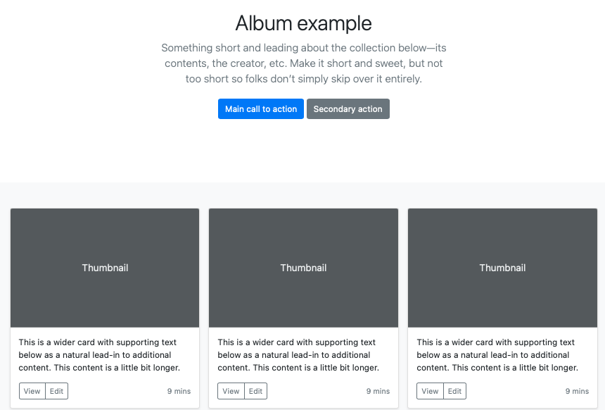
Album example Great for presenting something that is very image centric

Slide 4
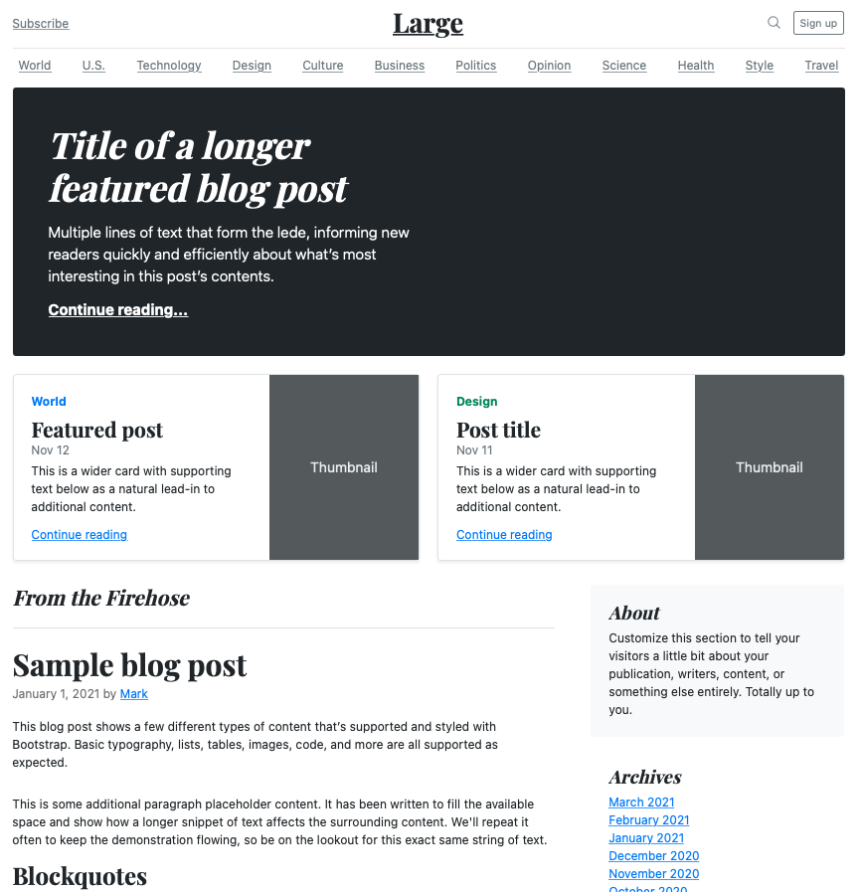
Blog example

Slide 5
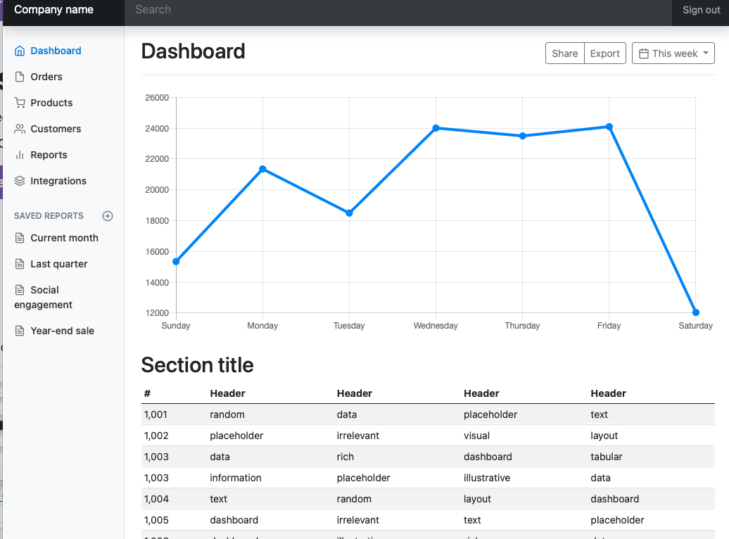
Dashboard example

Slide 6
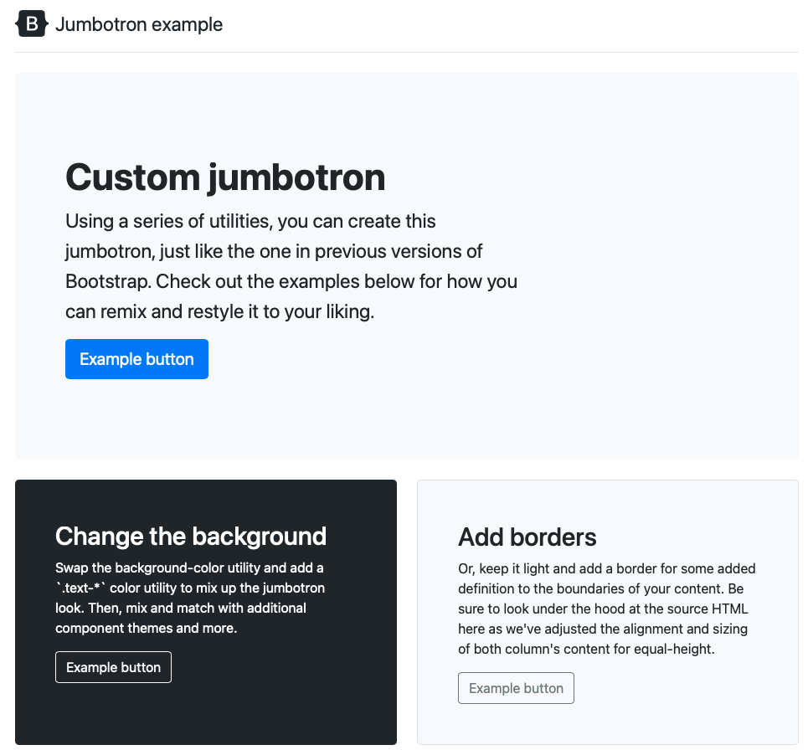
Jumbotron example The famous

Slide 7
Choose an example and make it your own

Slide 8
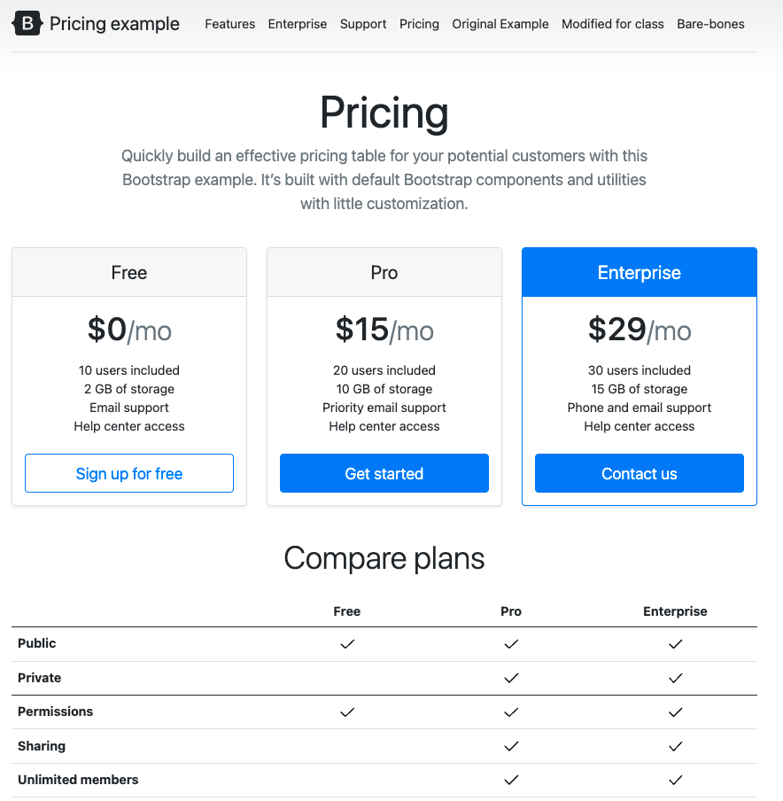
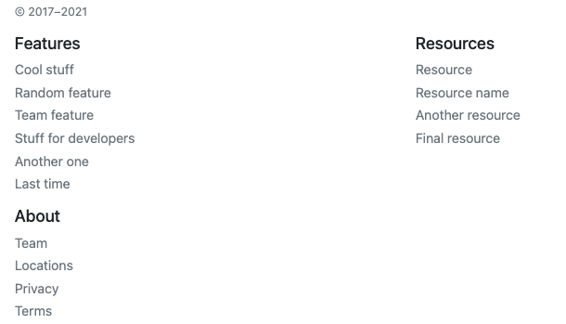
I Chose the ‘Pricing’ example
Nice for showing different levels of service
Compare them side-by-side
Good Navigation
Nice footer

Slide 9
I’ll use it to give a snapshot of our class
What is the course about?
What happens each week?
Where are the tests?
When are the assignments?

Slide 10
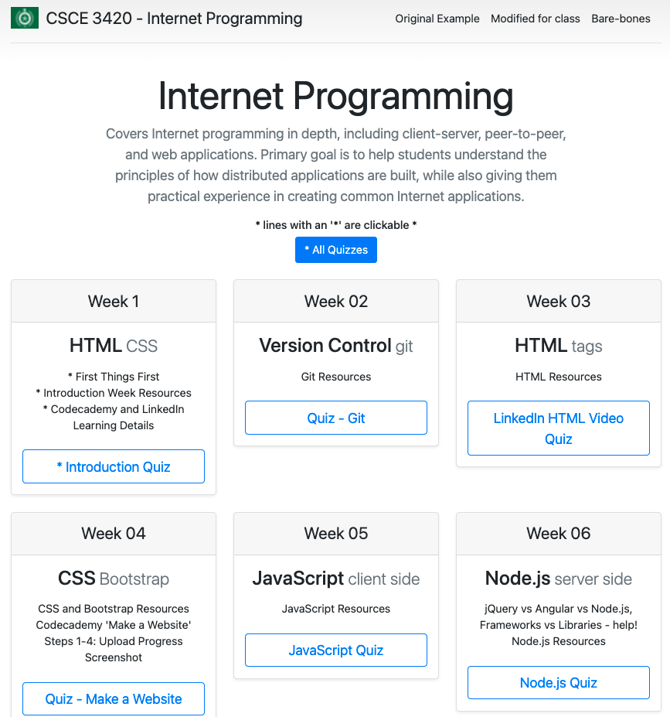
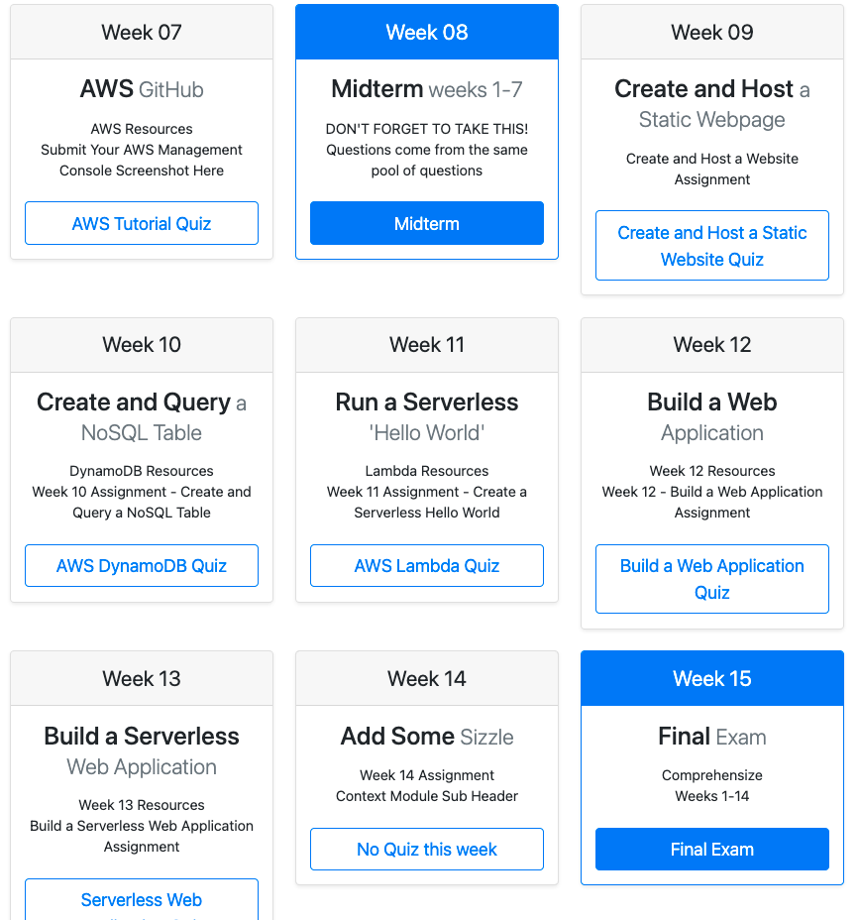
The ‘Pricing’ example reimagined

Slide 11
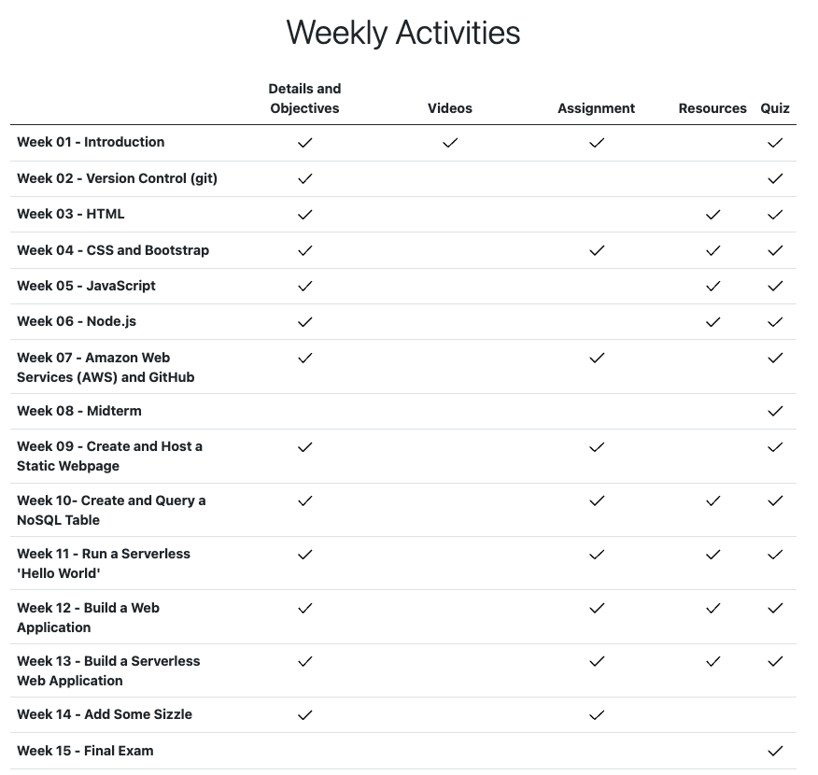
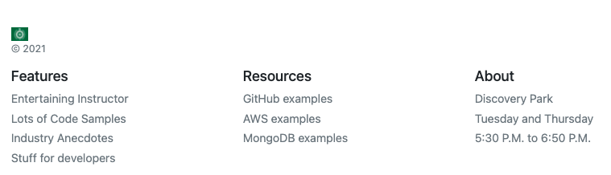

Slide 12
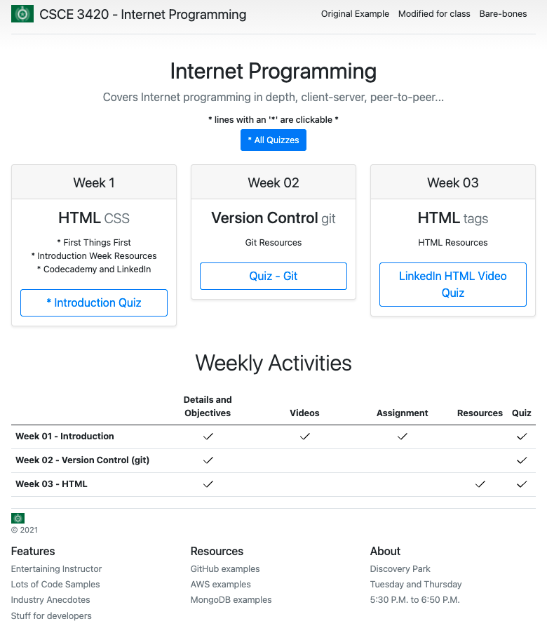
Stripped down
I don’t want to overwhelm you with examples
This page has just a few of each style
Looking at the HTML should not be too much to absorb

Slide 13
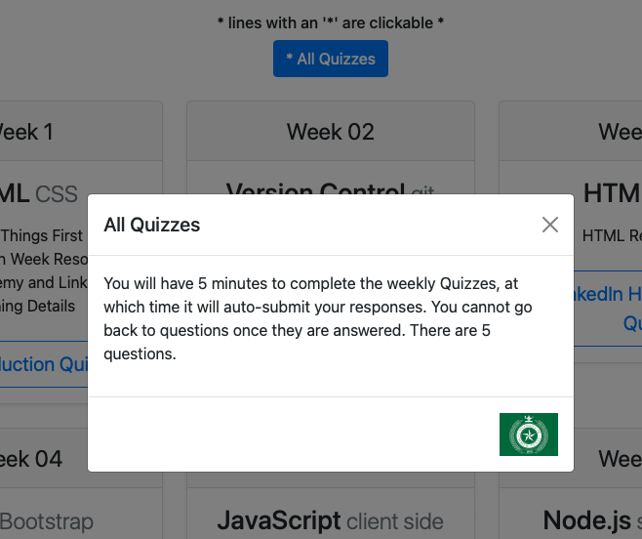
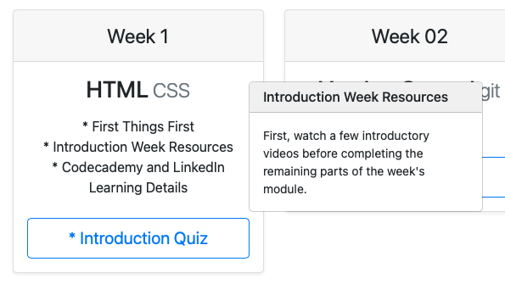
With a few extras found in the Cheat sheet example
Added in a modal for the quizzes button
And popovers for the weekly topics

Slide 14
Next step is to move to AWS

Slide 15
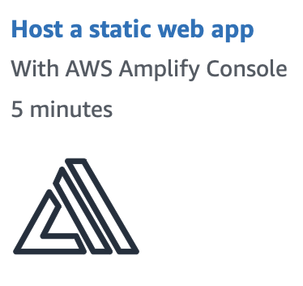
Lets build a static web app
https://aws.amazon.com/getting-started/hands-on/host-static-website/

Slide 16
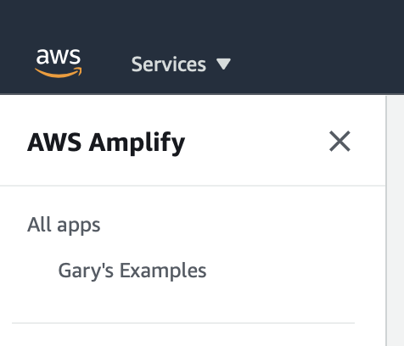
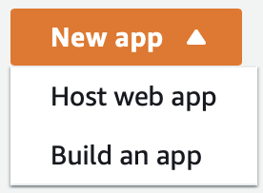
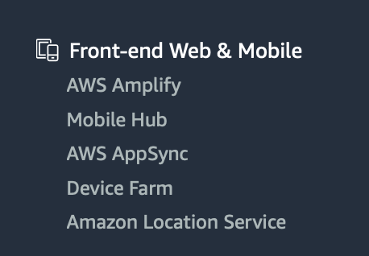
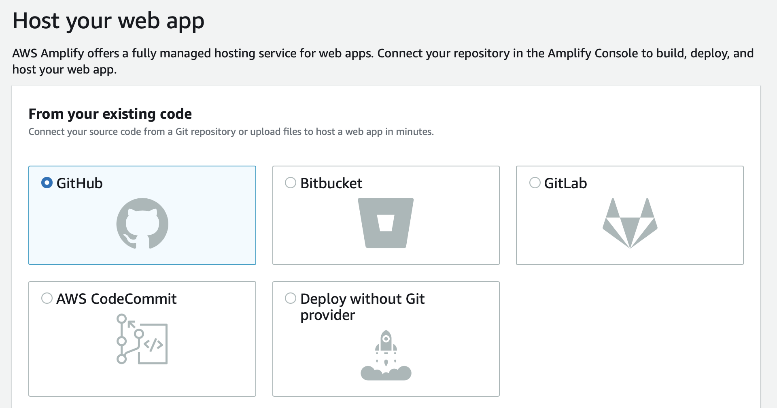
Amplify Console
In the Amplify console
Choose New App
Choose GitHub as the source for the code

Slide 17
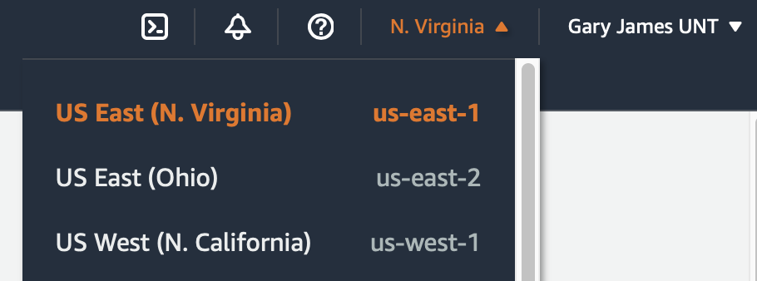
Amplify Console
Note your URL:
https://us-east-2.console.aws.amazon.com/amplify/home?region=us-east-2#/
It has your region specified

Slide 18
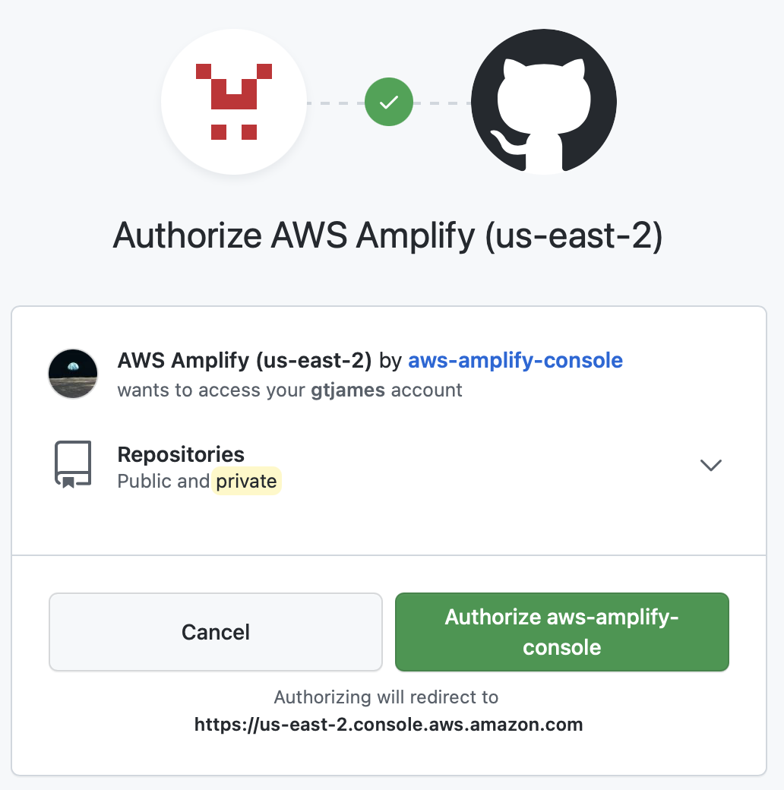
Go through the connection process to GitHub
You will sign into GitHub to tie your two accounts together

Slide 19
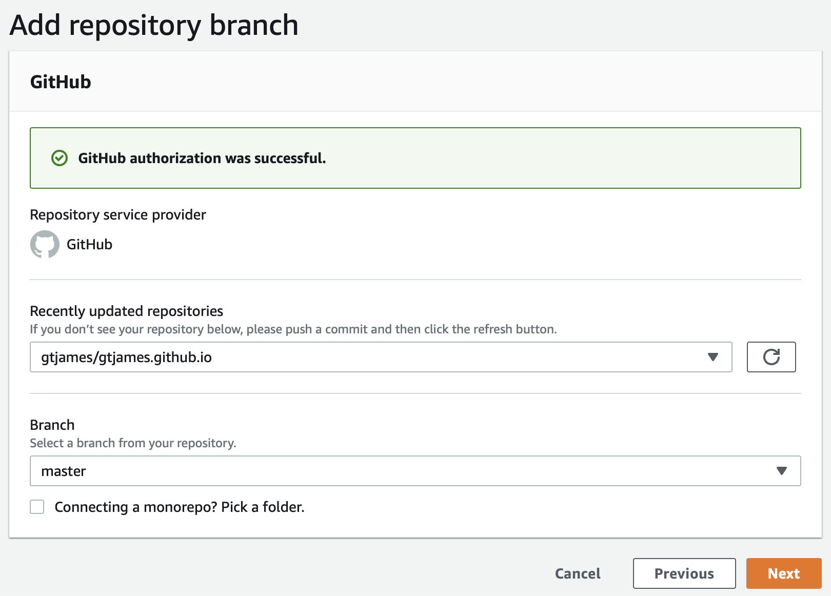
Add repository branch
AWS will make an API call out to GitHub to get a list of all of your repos
The Recently updated repositories drop down will be loaded in date order
You can also choose which BRANCH to deploy.

Slide 20
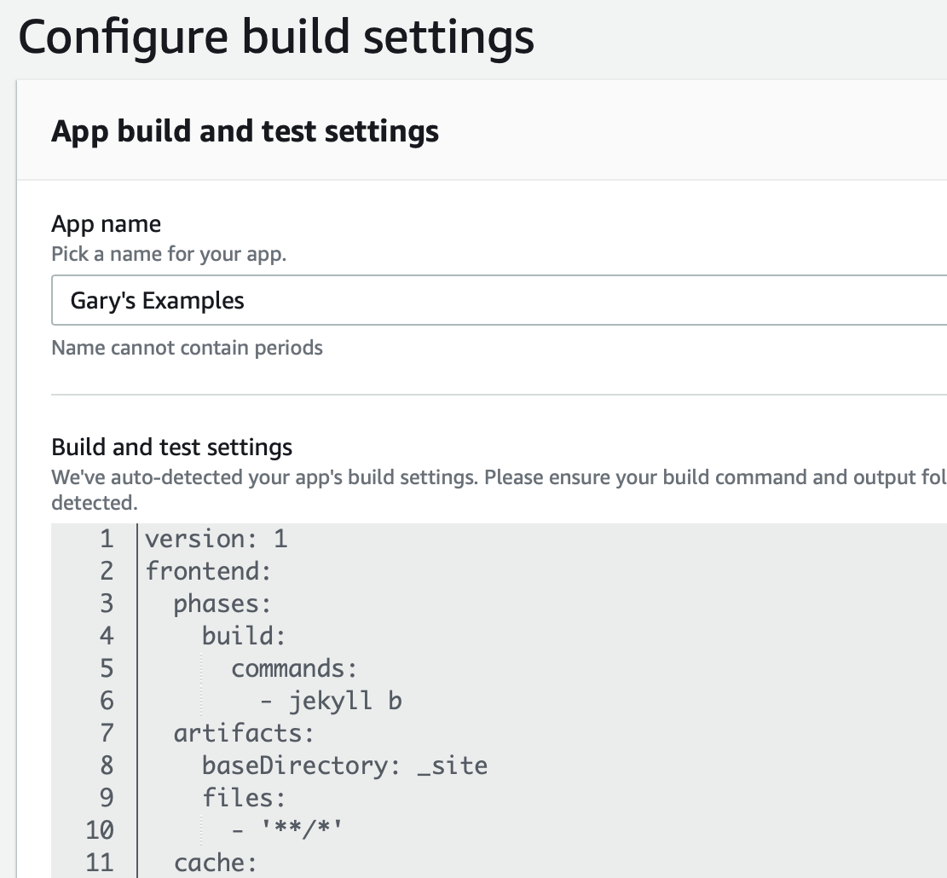
Configure build settings
Nothing needs to be altered here

Slide 21
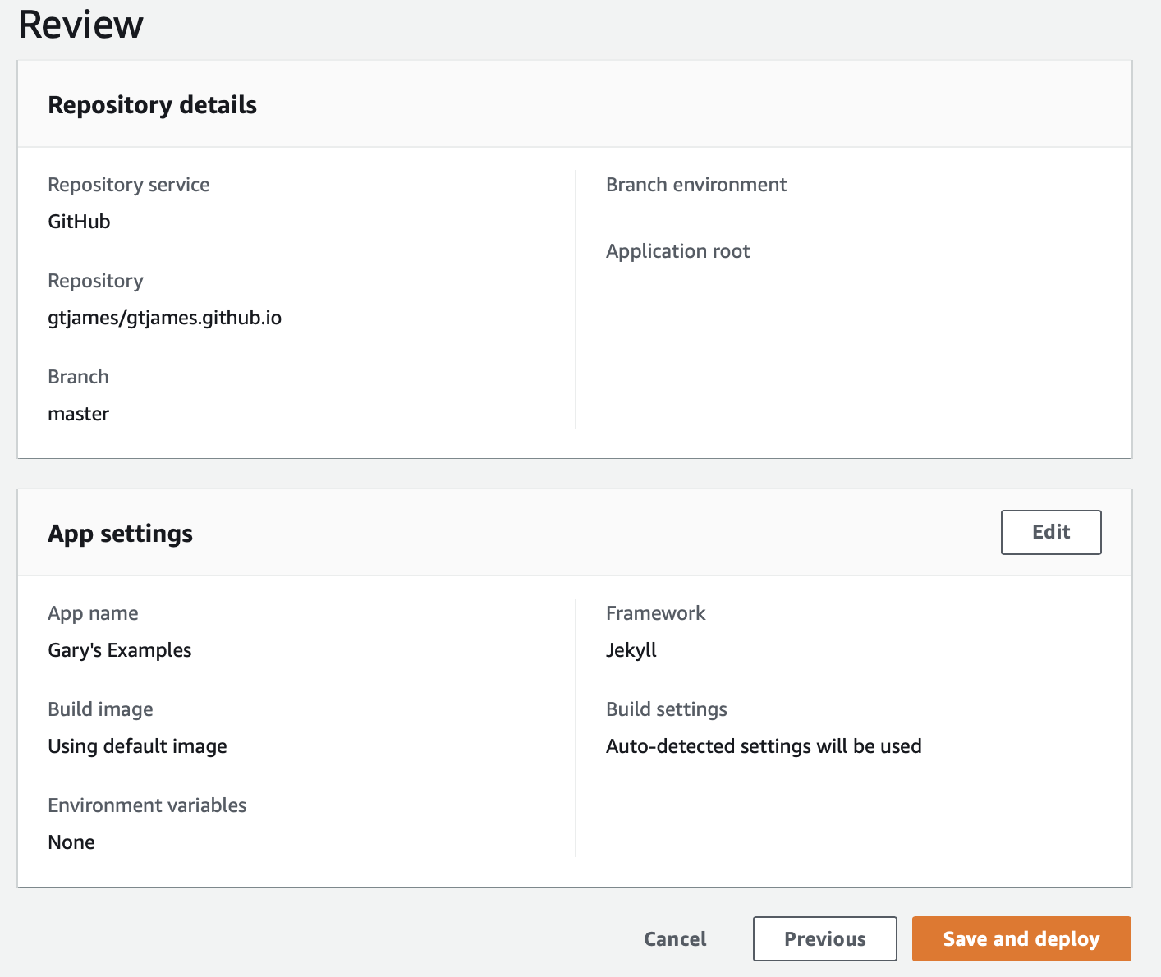
Review and Deploy!

Slide 22
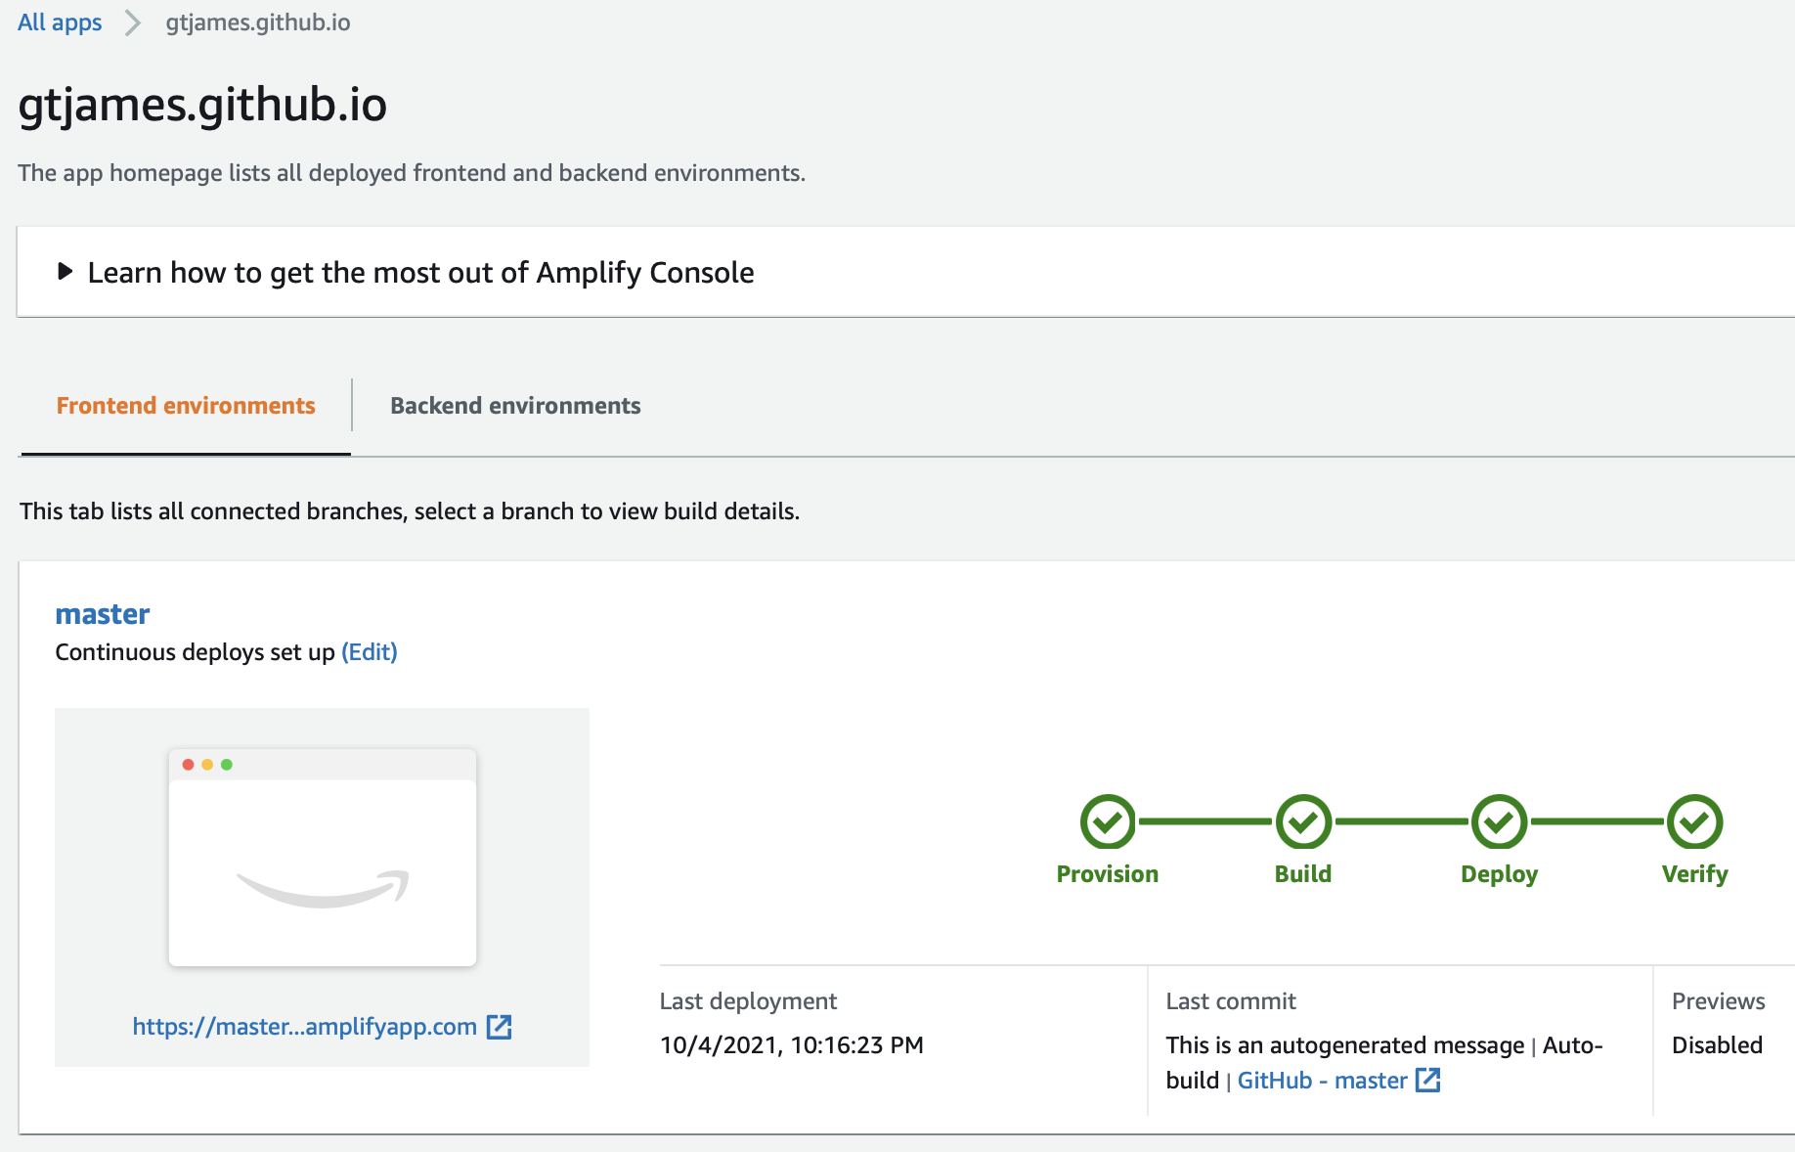
The workflow to move your code to AWS begins

Slide 23
You may see references to Amplify v. Beanstalk
Amplify: ”JS Open Source Library with React, React Native Extensions"
A JavaScript library for frontend and mobile developers building cloud-enabled applications.
Makes common tasks easier to add into your application.
The default implementation works with AWS resources but is designed to be open for usage with other cloud services that wish to provide an implementation or custom backends.
Beanstalk: "Private code hosting for teams"
A single process to commit code, review with the team, and deploy the final result to your customers.

Slide 24
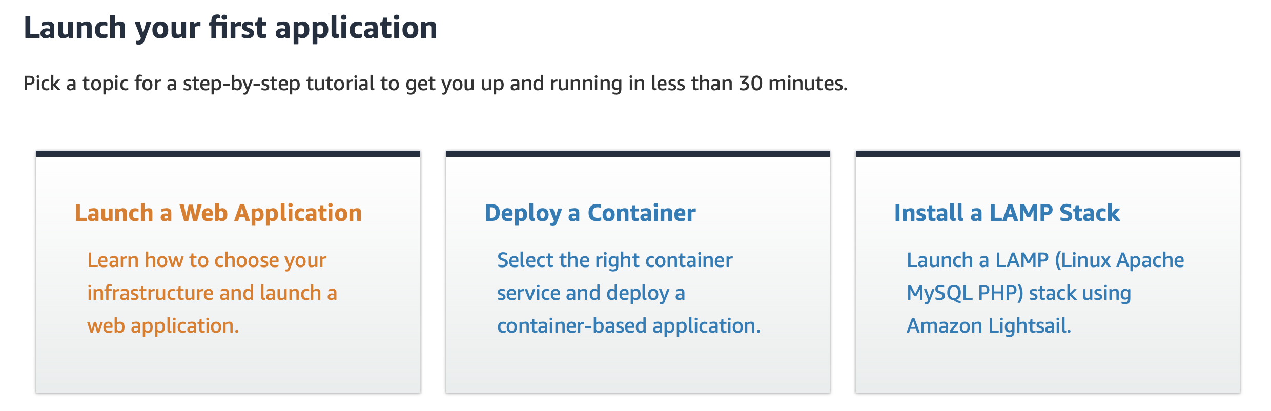
A Getting started link for your first app
https://aws.amazon.com/getting-started/?e=gs2020&p=console/#Launch_Your_First_Application

Slide 25
Find the hands-on tutorials for your AWS needs
https://aws.amazon.com/getting-started/hands-on/?getting-started-all.sort-by=item.additionalFields.sortOrder&getting-started-all.sort-order=asc&awsf.getting-started-category=category%23mobile&awsf.getting-started-level=level%23100&awsf.getting-started-content-type=content-type%23hands-on

Slide 26
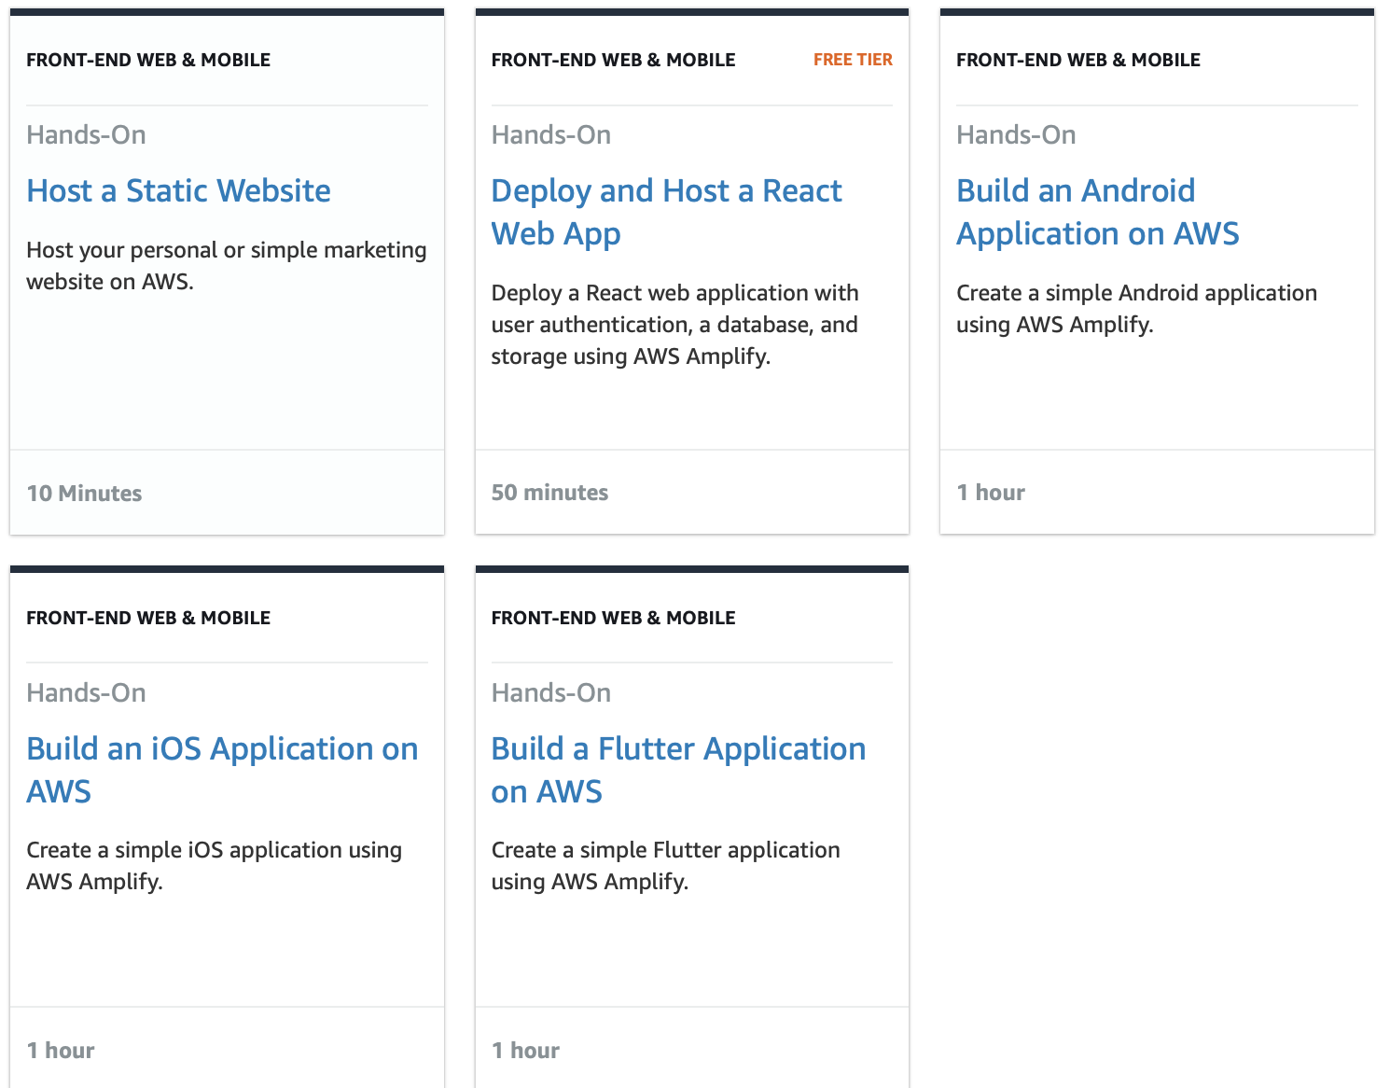
Find the hands-on tutorials for your AWS needs

Slide 27
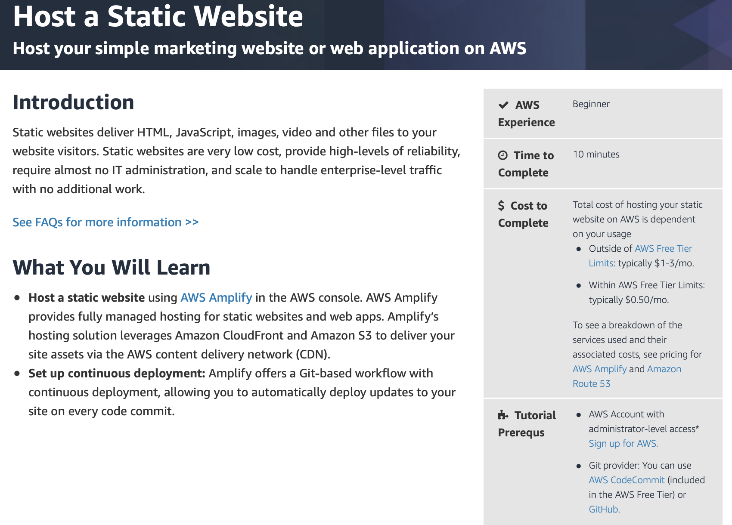
Host a Static Website

